Slide 1
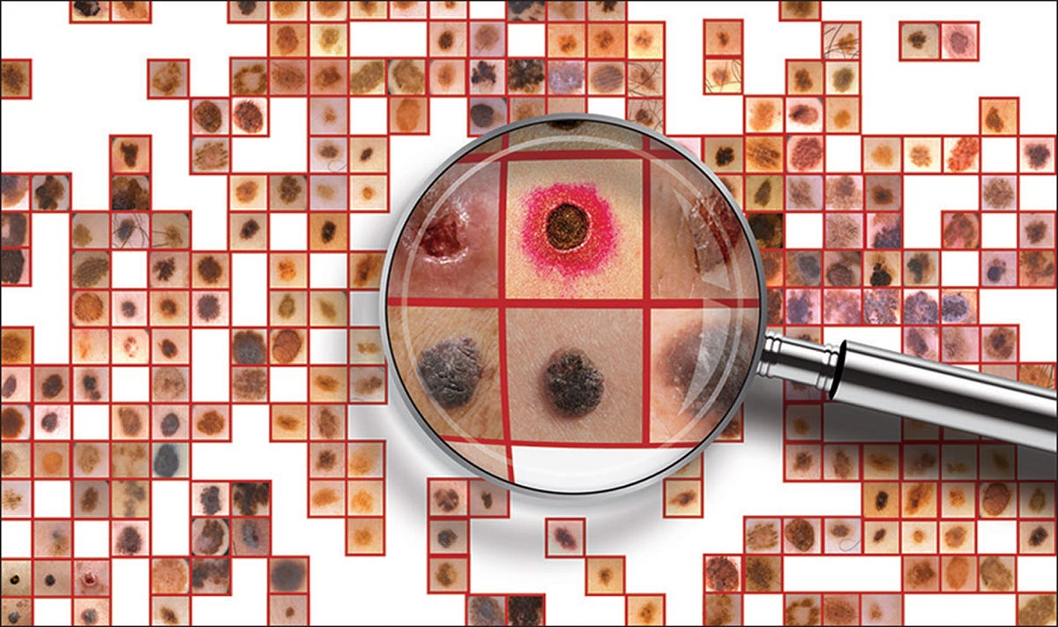
Skin Cancer Classification using CNN
Alyssa Westberg
SAT 5165

Slide 2
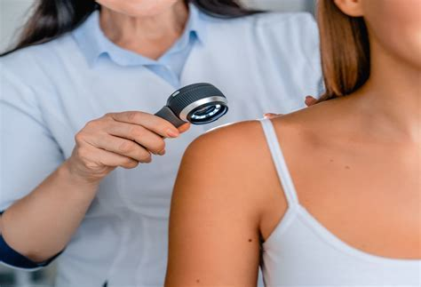
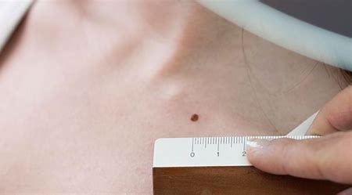
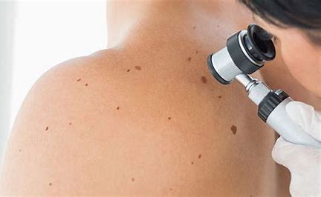
The Problem
Create an automated code that will classify skin cancer images as benign vs malignant
Cancer is a vastly growing disease that takes the lives of at least 10 million people a year. Early detection of cancer can be the difference between life or death for a patient. This can also improve prognosis and treatments for the patients as well.

Slide 3
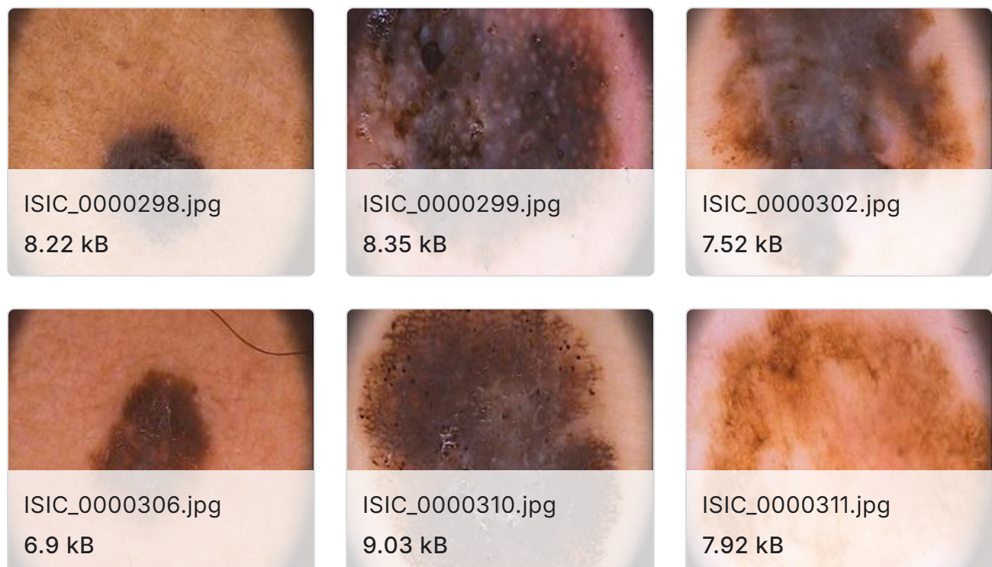
The Dataset
The dataset was taken from Kaggle. These images were collected from the International Skin Imaging Collaboration archive
Containing 1271 images that are labeled either Malignant or Benign
Data Distribution
Benign images- 1022 (719 in training, 303 in testing)
Malignant images 249 (176 in training, 73 in testing)
Data Splitting
Training set contains 1022 images (80%)
Testing set contains 249 images (20%)

Slide 4
The Design
VM1 and VM2
Send images to Data Directory
Preprocess Images
Convolutional Layer 1
Save Preprocessed Images
Convolutional Layer 3
Output Layer
Initialize Spark Session
Flatten Layer
Convolutional Layer 2
Load Images
Dense Layer
Read the Results!
Hyperparameters in VM2
Convolutional Layers
The filters ranging from 64 and 128
The Kernel size is 3
The Activation is ReLU
Dense Layer
The Units are 64
The Activation is ReLU
Output Layer
There is 1 unit
The Activation is Sigmoid

Slide 5
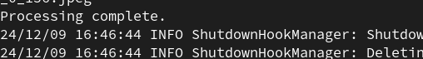
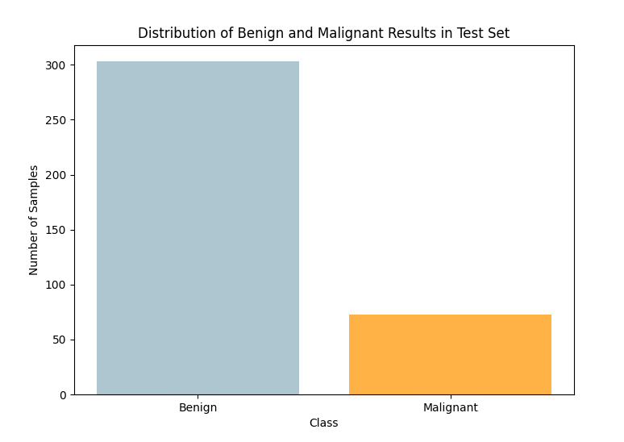
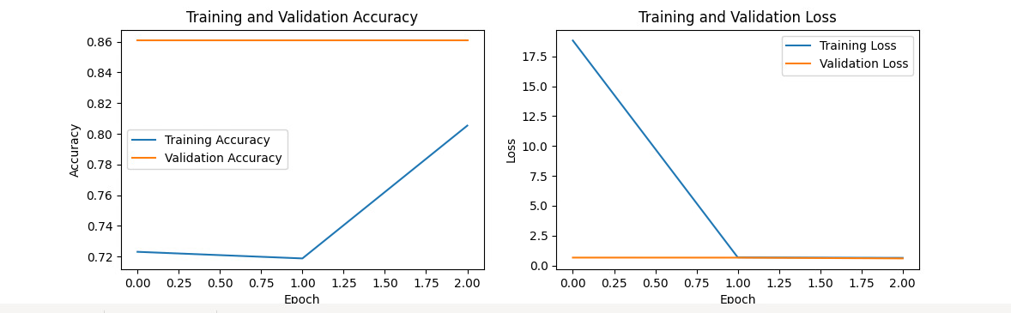
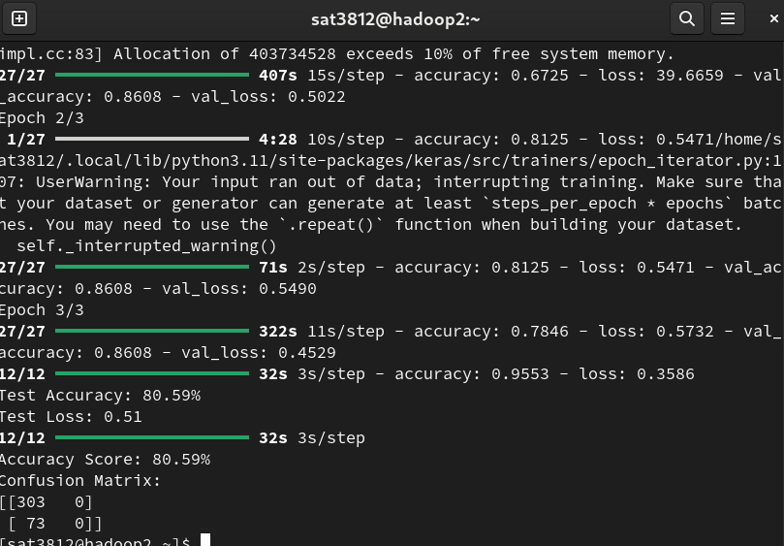
From VM1 the first code was able to successfully preprocess and save the images to a data directory for VM2 to be able to access it
Of the images the code pulled just over 300 images as benign and around 80 as malignant.
The code is running at an 80.5% accuracy score. This is not a bad score however with more hyperparameters this could increase accuracy and decrease overfitting
Results

Slide 6

Performance
Training
Testing
Accuracy
Accuracy and Loss results show the accuracy of each of the batches and the and the loss showing the value of the error that each batch had.
Higher numbers means there are more training that needs to be done
This is the same as the training but with the test batches of the dataset
The overall accuracy will give us how well the code is performing. Those results will be on the next slide with explanations
Overall Performance
There is a high accuracy with a low loss in the training set and the testing set. Adding more Epochs would increase the accuracy even more but its taking a lot longer to run the code.
Overall the code is doing really well with the amount of images that it is reading through. Once more images are added then there need to be more hyperparameters to help with overfitting.

Slide 7
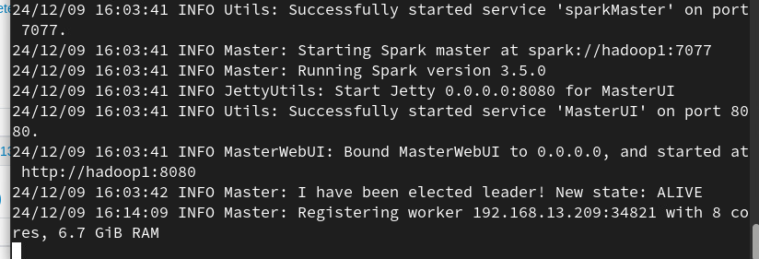
Testing Times and other screenshots

